Slide 1
AVR Week
Today's Agenda
> Basics of Microcontrollers and register algebra
> Blink
> Working of LCD

Slide 2
What is a MUC?
AVR (Atmega32 is the one we will be using ) microcontroller is considered to be a computer on a chip. The microcontroller is able to execute a set of instructions in the form of a program
These microcontrollers control and sense the surrounding electronics and environment. For example, microcontrollers can provide output to a display, motor, LEDS, etc., sensing the environment, such as tilt using an accelerometer, light, angular velocity using a MEMS (Microelectromechanical System) gyroscope, sound, encoders for movement, temperature, and button or keyboard input.
Each pin has a special assignment, or can be used as an input or output feature, with a few exceptions, the power pins.
Opens up to something known as physical computing applications

Slide 3
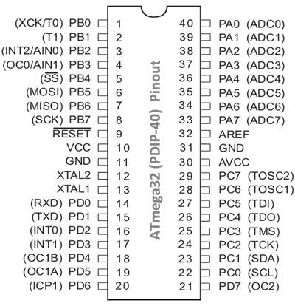
What Does it Do? And How?
Features (See the First page of Datasheet)

Slide 4
Registers!!
A register is a special storage space in which the state of the bits in the register have some special meaning to the AVR microcontroller. In short a register is simply a memory location that makes the microcontroller react in some way. We use a register to set a state for the microcontroller, or make the microcontroller do something.
ATMEGA32 registers are of 8-bits which is its computing power.
Most registers will have unique names, we will use them as we go along.
Datasheet is the GOD!
Let's brush up the register algebra/ bitwise operations.

Slide 5
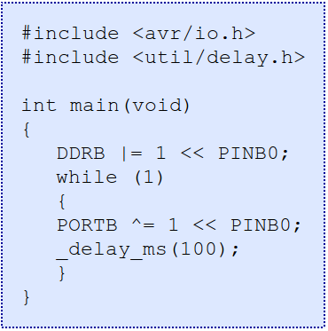
CODE !! (Finally :P)

Slide 6
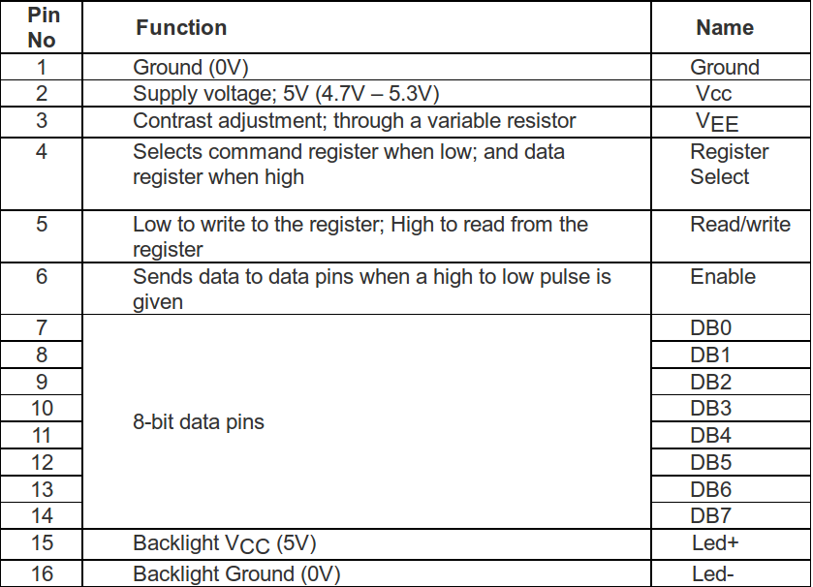
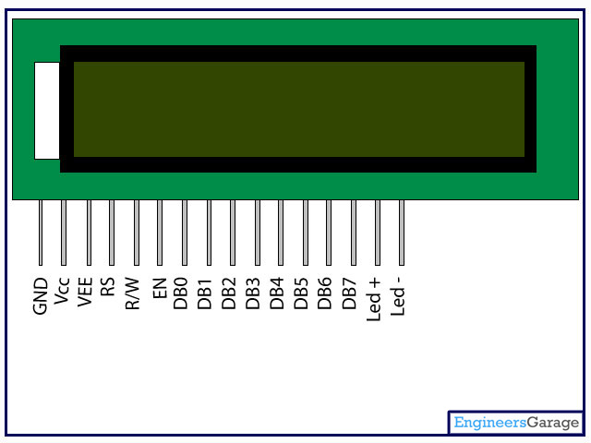
16x2 LCD!

Slide 7
Tomorrow!
We will interface an LCD and write its library.
Along with that we will do the ADC implementation.

